Slide 1
Chapter 16 JavaFX UI Controls and Multimedia
16.1 Introduction 644
16.2 Labeled and Label 644
16.3 Button 646
16.4 CheckBox 648
16.5 RadioButton 651
16.6 TextField 654
16.7 TextArea 655
16.8 ComboBox 659
16.9 ListView 662
16.10 ScrollBar 665
16.11 Slider 668
16.12 Case Study: Developing a Tic-Tac-Toe Game 671
16.13 Video and Audio 676
16.14 Case Study: National Flags and Anthems 679

Slide 2
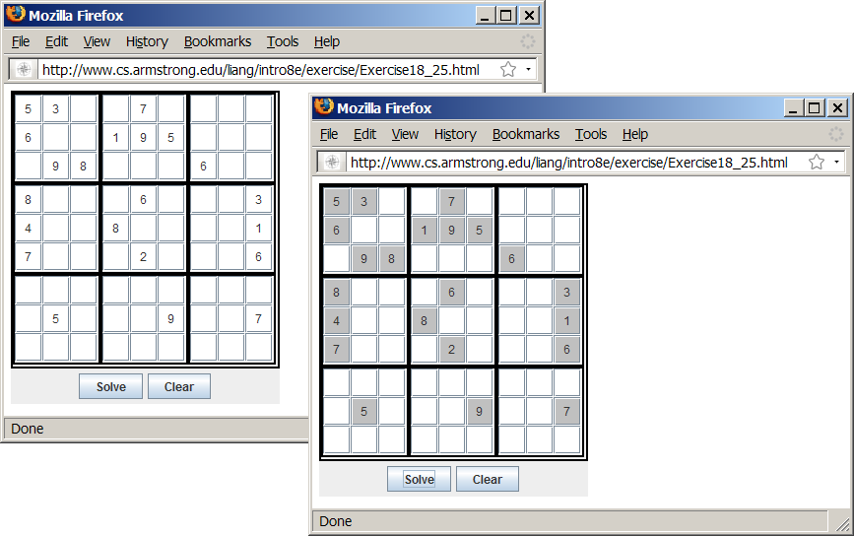
Motivations
When browsing the Web, you frequently see the GUI and animation developed using Java. These programs are called Java applets. Suppose you want to develop a Java applet for the Sudoku game. How do you write this program?
Sudoku
Notes:
运行 java applet时提示：您的安全设置已阻止本地应用程序运行.
控制面板->程序->Java->安全
将安全级别调至“中”

Slide 3
Objectives
To convert GUI applications to applets (§18.2).
To embed applets in Web pages (§18.3).
To run applets from Web browsers and from the appletviewer (§§18.3.1-18.3.2).
To write a Java program that can run as both an application and an applet (§18.4).
To override the init, start, stop, and destroy methods in the Applet class (§18.5).
To pass string values to applets from HTML (§18.6).
To develop an applet for the TicTacToe game (§18.7).
To develop an animation for a bouncing ball (§18.8).
To locate resources (images and audio) using the URL class (§18.9).
To play audio in any Java program (§18.10).

Slide 4
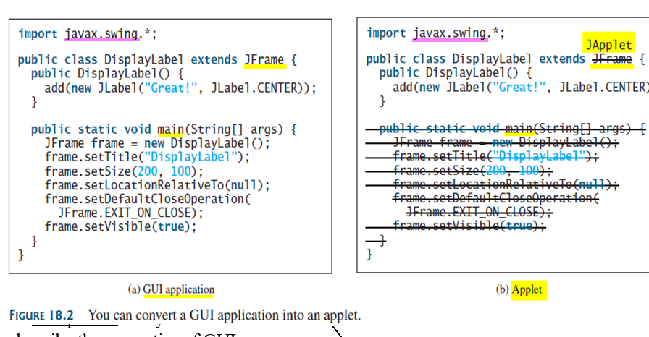
Developing Applets
Replace JFrame with JApplet
Delete the main method
Notes:
Every Java GUI program can be converted into an applet by replacing JFrame with JApplet and deleting the main method.

Slide 5
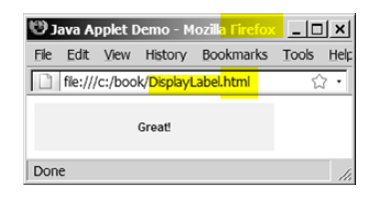
Developing Applets
Replace JFrame with JApplet
Delete the main method
Notes:
Every Java GUI program can be converted into an applet by replacing JFrame with JApplet and deleting the main method.

Slide 6
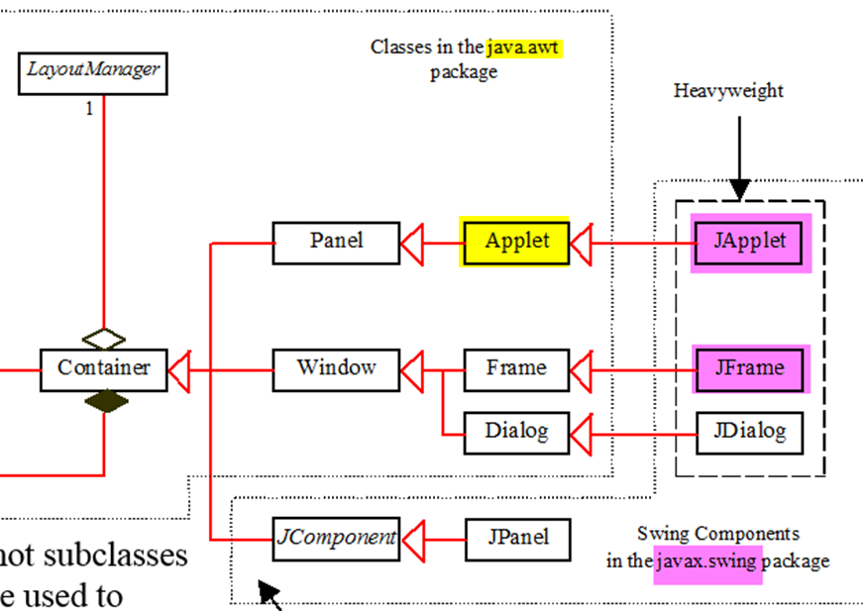
  import java.applet.*;
  import java.awt.*;
Like JFrame， JApplet is a container that can contain other GUI components
Notes:
Swing vs. AWT : GUI ( chapter 12)
awt,swing都可以用来构建JAVA应用程序，他们完全可以独立于浏览器运行，而APPLET是内嵌于浏览器执行的（当然，也可以用appletviewer进行测试和运行）,可以象应用程序一样在APPLET中使用awt,swing的组件。一般用户界面简单的话，就用AWT，如果比较复杂，就用SWING，SWING在AWT的基础上添加了不少功能强大的组件,又比AWT美观。

Slide 7
Applet class provides the framework that enables applet to be run from a web browser
Incorporate applets into a web page
  Create HTML file with <applet> tag
Notes:
Applet类提供一个基本框架，使得applet可以通过Web浏览器来运行，applet没有main方法，它依靠浏览器调用Applet类中的方法。
Applet类没有考虑与Swing组件一起工作，所以从Applet类扩展出了一个JApplet类。JApplet的内容窗格使用BorderLayout布局管理器。
Every applet is a subclass of java.applet.Applet ？
import java.applet.*;
import java.awt.*;

Slide 8
A Simple Applet
<html>
<head>
<title>Java Applet Demo</title>
</head>
<body>
<applet
code = "DisplayLabel.class"
width = 350
height = 200>
</applet>
</body>
</html>
tag name
attribute
Notes:
P616

Slide 9
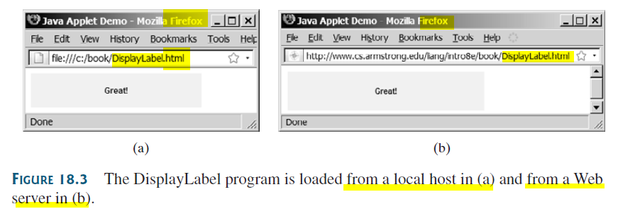
In (b): you need to store the DisplayLabel.class and DisplayLabel.html on a Web server

Slide 10
The <applet> HTML Tag (P616)
<applet
code=classfilename.class
width=applet_viewing_width_in_pixels
height=applet_viewing_height_in_pixels
[archive=archivefile]
[codebase=applet_url]
[vspace=vertical_margin]
[hspace=horizontal_margin]
[align=applet_alignment]
[alt=alternative_text]
>
<param name =param_name1
value= param_value1>
</applet>
required
the others: optional

Slide 11
Applications vs. Applets
Similarities
  JFrame and JApplet
    both are subclasses of the Container class
    features （ user interface components, layout managers, and event-handling ) are the same for both classes.
Differences
  GUI Applications ：
    placed in a frame
    invoked from the static main method by the Java interpreter
  Applets
    placed in a Web browser
    run by the Web browser.
    have security restrictions

Slide 12
Security Restrictions on Applets
Applets are not allowed to
Read/Write the file system of the computer viewing the applets.
run any programs on the browser’s computer.
establish connections between the user’s computer and another computer except with the server where the applets are stored.

Slide 13
Conversions Between Applications and Applets
Conversions are simple and easy.
You can always convert an applet into an application.
You can convert an application to an applet as long as security restrictions are not violated.

Slide 14
How to enable an Applet to run as an Application?
import javax.swing.*;
public class DisplayLabel extends JApplet {
public DisplayLabel() {
add(new JLabel("Great!", JLabel.CENTER));
}
}
you need only add a main method in the applet class.
Notes:
So to run in two ways

Slide 15
Enabling Applets to Run as Applications
import javax.swing.*;
public class DisplayLabel extends JApplet {
public DisplayLabel() {
add(new JLabel("Great!", JLabel.CENTER));
}
public static void main(String[] args) {
// Create frame
JFrame frame = new JFrame("Applet is in the frame");
// Create an instance of the applet
DisplayLabel applet = new DisplayLabel();
// Add applet to frame
frame.add(applet);
// Display frame
frame.setSize(300, 100);
frame.setLocationRelativeTo(null); // Center the frame
frame.setDefaultCloseOperation(JFrame.EXIT_ON_CLOSE);
frame.setVisible(true);
}
}

Slide 16
Enabling Applets to Run as Applications
import javax.swing.*;
public class DisplayLabel extends JApplet {
public DisplayLabel() {
add(new JLabel("Great!", JLabel.CENTER));
}
public static void main(String[] args) {
// Create frame
JFrame frame = new JFrame("Applet is in the frame");
// Create an instance of the applet
DisplayLabel applet = new DisplayLabel();
// Add applet to frame
frame.add(applet);
// Display frame
frame.setSize(300, 100);
frame.setLocationRelativeTo(null); // Center the frame
frame.setDefaultCloseOperation(JFrame.EXIT_ON_CLOSE);
frame.setVisible(true);
}
}
The class is both an applet and an application
When run from web browser
  Browser creates an instance of the applet and display it
When run standalone
  main() is performed to create a frame to hold the applet

Slide 17
The Applet Class
Web browser
  When the applet is loaded, creates an instance of the applet using the applet’s no-arg constructor
  controls the applet using the init, start, stop, and destroy methods.
    By default, these methods do nothing.
    To perform specific functions, they need to be modified in the user's applet so that the browser can call your code properly.
Notes:
Web browser
(When the applet is loaded) creates an instance of the applet using the applet’s no-arg constructor,
controls and executes the applet through the init, start, stop, and destroy methods.

Slide 18
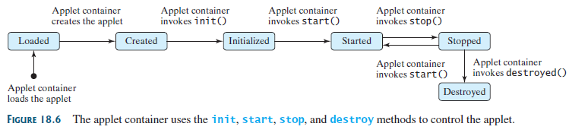
Browser Calling Applet Methods

Slide 19
The init() Method
Invoked when the applet is first loaded and again if the applet is reloaded.
A subclass of Applet should override this method if the subclass has an initialization to perform.
  initialization include: loading images, getting string parameter values from the <applet> tag in the HTML page, creating new threads, …
Notes:
initialization include: loading images, setting up user-interface components, and getting string parameter values from the <applet> tag in the HTML page， creating new threads.

Slide 20
The start() Method
Invoked after the init() method is executed; also called whenever the applet becomes active again (e.g., when the user returns to the page containing the applet after surfing other Web pages).
Overrides this method if it has any operation that needs to be performed whenever the Web page containing the applet is visited.
  An applet with animation, for example, might use the start method to resume animation.

Slide 21
The stop() Method
The opposite of the start() method, which is called when the user moves back to the page containing the applet; the stop() method is invoked when the user moves off the page.
Overrides this method if it has any operation that needs to be performed Whenever the Web page containing the applet is no longer visible.
  When the user leaves the page, any threads that the applet has started but not completed will continue to run. You should override the stop method to suspend the running threads so that the applet does not take up system resources when it is inactive.

Slide 22
The destroy() Method
Invoked when the browser exits normally to inform the applet that it is no longer needed and that it should release any resources it has allocated.
Overrides this method if it has any operation that needs to be performed before it is destroyed.
  Usually, you won't need to override this method unless you wish to release specific resources, such as threads that the applet created.

Slide 23
Summary: writing Applets
extends the JApplet class in Swing package.
  Override init(), start(), stop(), and destroy() if necessary. By default, these methods are empty.
  Add your own methods and data if necessary.
embedded in an HTML page.

Slide 24
Passing Parameters from HTML source to Applets
<applet
code = "DisplayMessage.class"
width = 200
height = 50>
<param name=MESSAGE value="Welcome
to Java">
<param name=X value=20>
<param name=Y value=20>
alt="You must have a Java-enabled browser to view the applet"
</applet>
Notes:
从这里开始，不再讲了。。。

Slide 25
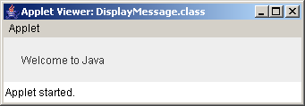
Example: Passing Parameters to Java Applets
Objective: Display a message at a specified location. The message and the location (x, y) are obtained from the HTML source.
Notes:
在eclipse里面怎么创建Applet? html文件和你的.class文件位于同一文件夹下。
目录结构必须是下面的这个样子才可以：
如有一个hello.html
在同一级目录中要新建一个文件夹叫javaApplet
在这个文件夹下要有AppletPara2.class,可以把编译好的class考到这个文件夹中来
文件->新建一个java project->建一个类继承Applet ->重写init() 、start()、paint()等 方法（看自己需要）

Slide 26
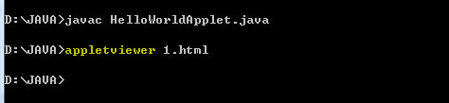
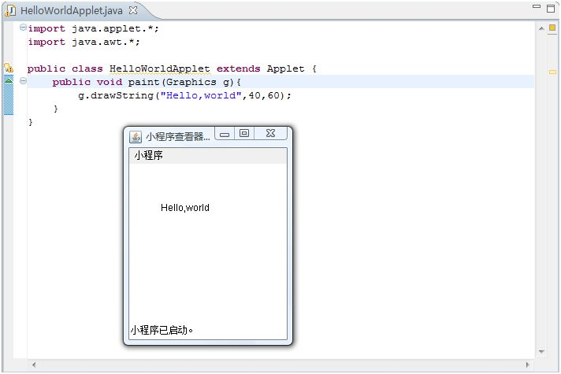
In the command line, use JDK tool: appletviewer
In Eclipse，Without HTML document ，directly Run Applet
Notes:
In Eclipse下，Without creating HTM
In Eclipse下，Without HTML文件，也可直接Run运行 Applet程序
JDK工具 appletviewer命令详解
如果你浏览器没有安装Java插件，那只能依靠这个工具来浏览Applet了。直接在控制台输入appletviewer即可。
JDK安装目录下的demo/applets下面有大量的Applet程序。选其中一个。使用appletviewer进行浏览：
Applet现在已经是少人问津的技术了，但却曾让Java在Internat上掀起了热潮。Java早年在Web领域唯一的卖点就是Applet，有一段时间非常流行Applet做的动画、聊天室和游戏，那时的浏览器包括IE、Netscape都是包含JVM的。后来微软不打算在IE中包含JVM了，导致Applet失去用户群(不是每个浏览器都装Java)。Applet不流行，我不认为完全是Applet自身的问题，假设Applet能流行至今，它的很多问题肯定都能得到解决。

Slide 27
Example: Running a Program as an Applet and as an Application
Objective: Modify MessageApplet to enable it to run both as an applet and as an application.

Slide 28
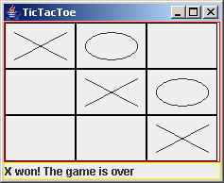
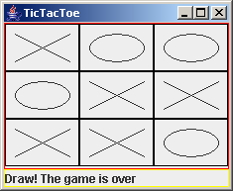
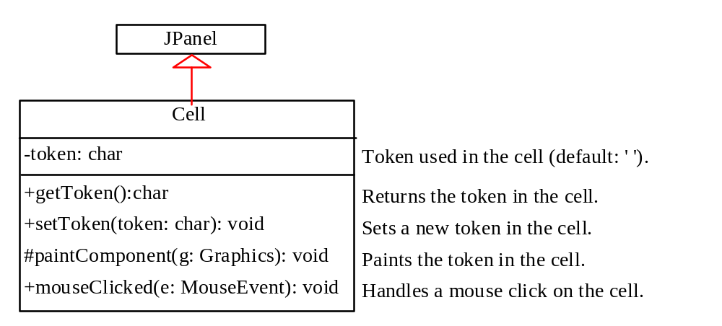
Case Study: TicTacToe

Slide 29
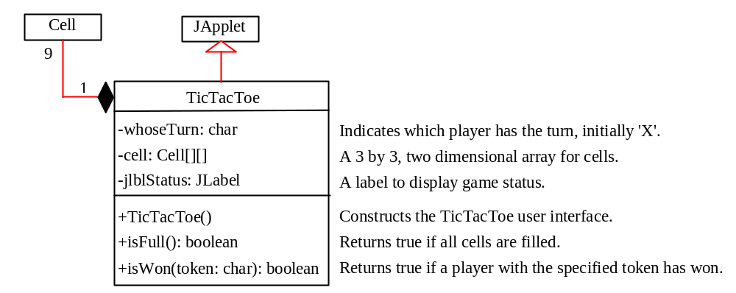
Case Study: TicTacToe, cont.
TicTacToe
Run as Application
Run as Applet

Slide 30
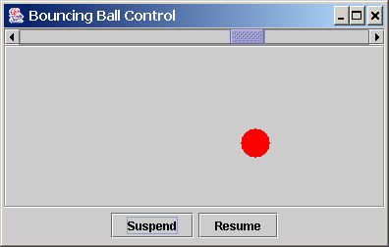
Case Study: Bouncing Ball
Objective: Write an applet that displays a ball bouncing in a panel. Use two buttons to suspend and resume the movement and use a scroll bar to control the bouncing speed.

Slide 31
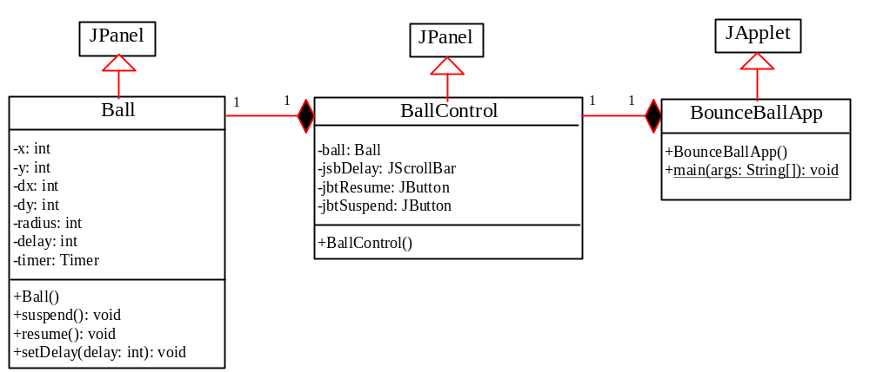
Case Study: Bouncing Ball, cont.
Ball
BallControl
BounceBallApp
Run

Slide 32
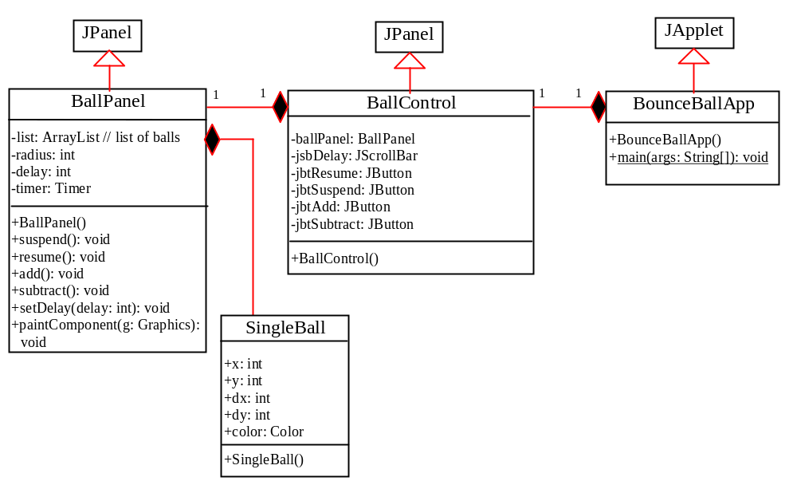
Exercise for extending to multiple balls

Slide 33
Locating Resource from Applets
Due to security restrictions, applets cannot access local files.
How can an applet load resource files for image and audio?

Slide 34
Creating ImageIcon Using Absolute File Names
Example:
  ImageIcon imageIcon = new ImageIcon("c:\\book\\image\\us.gif");
  jlbl.setIcon(imageIcon);
This approach suffers a problem. The file location is fixed since it uses the absolute file path on Window. Thus, the program cannot run on other platforms

Slide 35
Creating ImageIcon Using Relative File Names
Assume that image/us.gif is under the class directory, you can circumvent this problem by using a relative path as follows:
  ImageIcon imageIcon = new ImageIcon("image/us.gif");
  jlbl.setIcon(imageIcon);
This works fine with Java applications on all platforms, but does not work with Java applets because applets cannot load local files.
To make it to work with both applications and applets, you need to locate the file using the URL class.

Slide 36
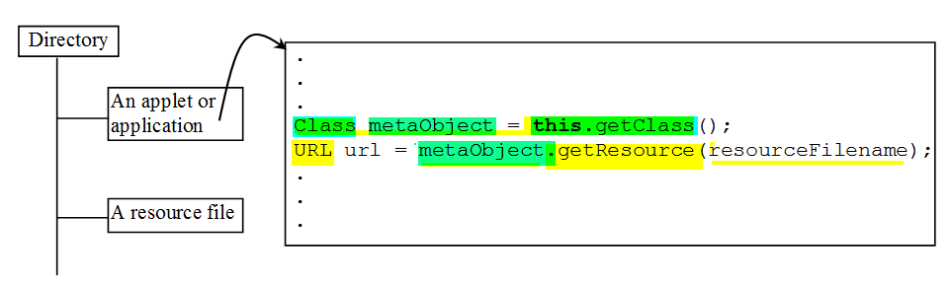
Locating Resource Using the URL Class
The java.net.URL class can be used to identify files (image, audio, text, etc.) on the Internet.
  In general, a URL (Uniform Resource Locator) is a pointer to a “resource” on the World Wide Web on a local machine or a remote host.
  A resource can be something as simple as a file or a directory.

Slide 37
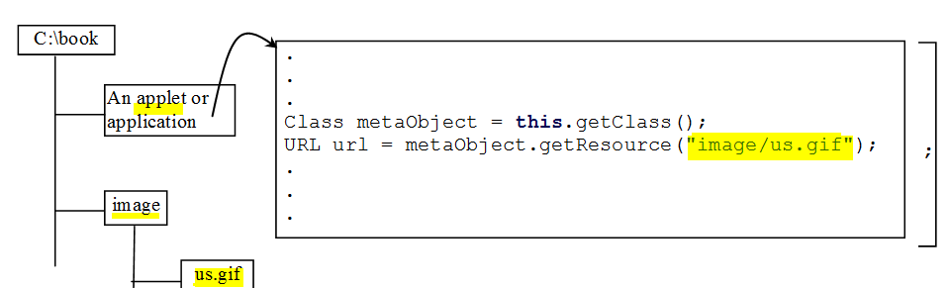
Creating a URL from a Class Reference
Display an image from /image/us.gif, located in the class directory
Notes:
A URL for a file can also be accessed from a class in a way that is independent of the location of the file, as long as the resource file is located in the class directory.

Slide 38
Creating AudioClip from an Audio File
Create an AudioClip for the beep.au audio file in the same directory with the class you are running.
  Class myclass = this.getClass();
  URL url = myclass.getResource("beep.au");
  AudioClip audioClip = Applet.newAudioClip(url);
Notes:
To play an audio file in an applet, first create an audio clip object for the audio file. The audio clip is created once and can be played repeatedly without reloading the file. To create an audio clip, use the static method newAudioClip() in the java.applet.Applet class:
AudioClip audioClip = Applet.newAudioClip(url);
Audio was originally used with Java applets. For this reason, the AudioClip interface is in the java.applet package.

Slide 39
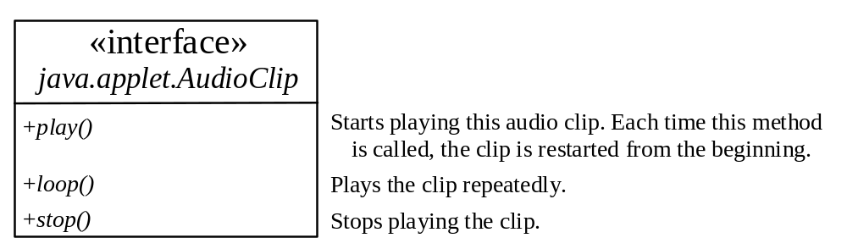
Playing Audio
To manipulate a sound for an audio clip, use the play(), loop(), and stop() methods in java.applet.AudioClip.
DisplayImagePlayAudio
Run

Slide 40
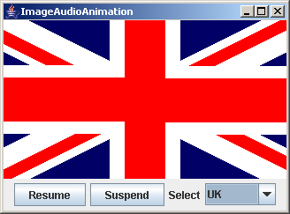
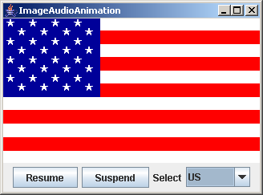
Multimedia Animation
ImageAudioAnimation
Run as an Application

Slide 41
Packaging and Deploying
Java Projects
Companion Website
What is JAR?
Java archive file can be used to group all the project files in a compressed file for deployment.
The Java archive file format (JAR) is based on the popular ZIP file format.
- can be downloaded from a web server to a browser
- can be deployed on an end-user’s machine
Notes:
This single file can be deployed on an end-user’s machine as an application. It also can be downloaded to a browser in a single HTTP transaction, rather than opening a new connection for each piece. This greatly simplifies application deployment and improves the speed with which an applet can be loaded onto a web page and begin functioning.

Slide 42
Creating JAR
Companion Website
e.g., create an archive file named TicTacToe.jar for classes TicTacToe.class and TicTacToe$Cell.class.
jar -cf TicTacToe.jar TicTacToe.class TicTacToe$Cell.class
  -c: create a new archive file
  -f : specify the archive file’s name.

Slide 43
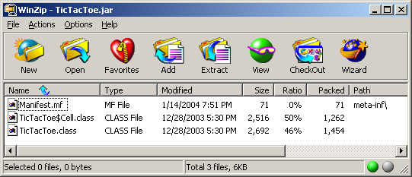
Viewing the Contents of a JAR File
Companion Website
You can view the contents of a .jar file using WinZip.

Slide 44
Manifest File
Companion Website
A manifest file was created with the path name meta-inf\. The manifest is a special file that contains information about the files packaged in a JAR file.
The manifest file must have an entry to contain the main class.
For instance, the manifest file in TicTacToe.jar contains the following information:
  Manifest-Version: 1.0
  Name: TicTacToe.class
  Java-Bean: True
  Name: TioTacToe$Cell.class
  Java-Bean: True
  Main-Class: TicTacToe
  Sealed: true
Notes:
You can modify the information contained in the manifest file to enable the JAR file to be used for a variety of purposes. For instance, you can add information to specify a main class to run an application using the .jar file.

Slide 45
Running Archived Projects Standalone
Companion Website
Run the .jar file using the java command from the directory that contains TicTacToe.jar,
  java -jar TicTacToe.jar
Notes:
TIP: You can write an installation procedure that creates the necessary directories and subdirectories on the end-user’s computer. The installation can also create an icon that the end-user can double-click on to start the program. For information on creating Windows desktop icon, please see www.prenhall.com/liang/intro5e.html.

Slide 46
Running Archived Projects As Applet
Companion Website
To run TicTacToe as an applet, modify the <APPLET> tag in the HTML file to include an ARCHIVE attribute.
For example, the HTML file for running TicTacToe can be modified as shown below:
    <APPLET
    CODE = "TicTacToe.class"
    ARCHIVE = "TicTacToe.jar"
    WIDTH = 400
    HEIGHT = 300
    HSPACE = 0
    VSPACE = 0
    ALIGN = Middle
    >
    </APPLET>
Notes:
The ARCHIVE attribute specifies the archive file in which the applet is contained.

